Slide 1

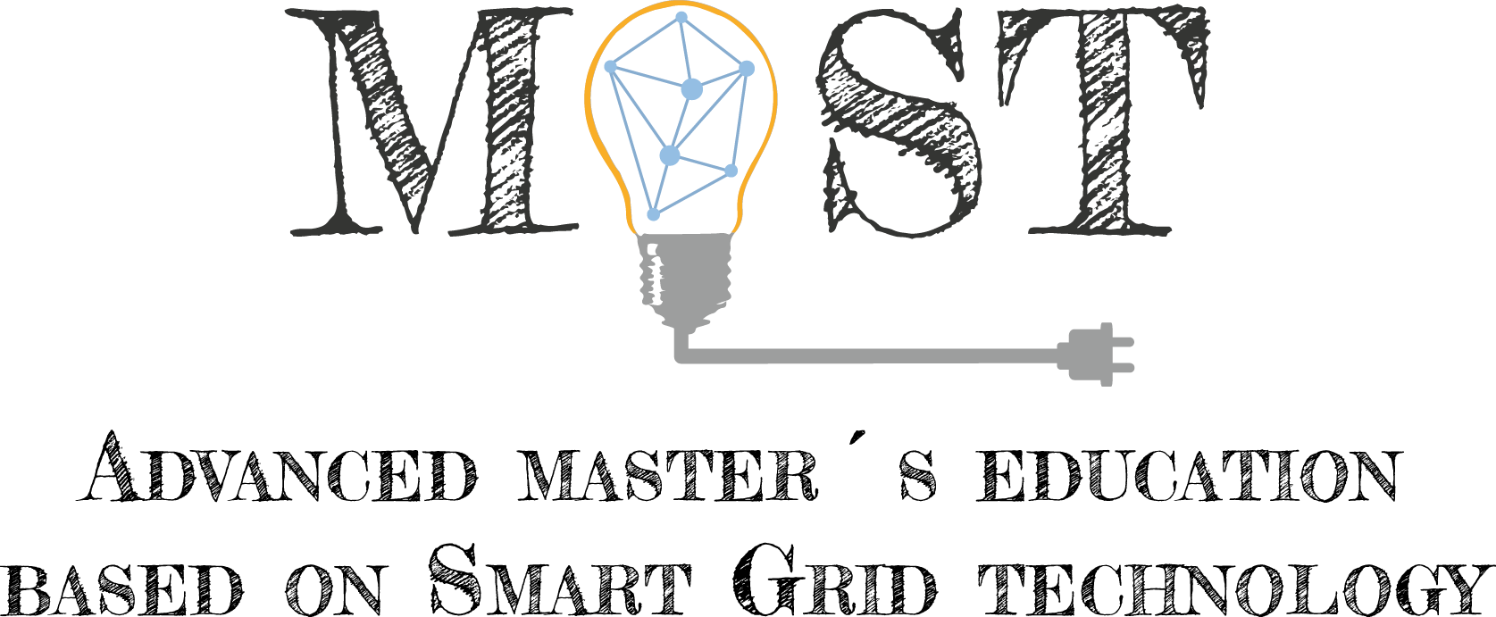
Lecture 2: The Blockchain technology, technical functionalities
[Mario Mureddu,
University ofCagliari] Day month year City, Country

Slide 2





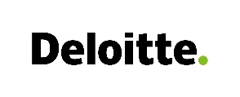

Course material developed in collaboration with University of Cagliari, University of Cyprus, University of Western Macedonia, Mines ParisTech, Technische Hochschule Ulm, Deloitte, WIP with support from Erasmus+

Slide 3
Content of the lecture
Interaction with blockchains
Decentralized virtual machines (Ethereum platform)
Smart contracts
Exercise: interaction with ethereum blockchain
Exercise: creation of smart contracts and interaction with them

Slide 4
What you should learn from this lesson
How to interact with a running blockchain
How the technology allows for decentralized automated computation (smart contracts)
Some warnings regarding to their capabilities
How to create a simple smart contract on Ethereum and how to interact with it

Slide 5
How to interact with a blockchain: get an account
Account on blockchains are represented by addresses. Each blockchain has an address standard which decides the address length and characteristics.
Address are unique identifiers: a user is an address. In reality, a single user can have more than one address, but different address will be treated by the blockchain as different users.
An address is public: once you have it, it will be your public identifier. As an example, other addresses will send money to your address!

Slide 6
How to get an address
Do you remember digital signature? We spoke about it in the previous lesson:
You have a private key x
From which (with some hashing procedure which is standard per each blockchain technology) you can get a public key y. It is easy to calculate y from x, but is nearly impossible to do the opposite.
With x, you can sign every digital message d by generating a string s, and whoever knows y can verify that you were the signer
Now, here comes the magic: you create a private key x (do it in a safe way!)
From it, calculate y and make it public. It will be your address! (almost, some blockchains make some other operations on it)
In this way, you are at the same time:
Saying you exist, and that all transactions headed to you should be sent at your address
You can digitally sign transactions coming from your address with your private key

Slide 7
How to get an address
Do you remember digital signature? We spoke about it in the previous lesson:
You have a private key x
From which (with some hashing procedure which is standard per each blockchain technology) you can get a public key y. It is easy to calculate y from x, but is nearly impossible to do the opposite.
With x, you can sign every digital message d by generating a string s, and whoever knows y can verify that you were the signer
Now, here comes the magic: you create a private key x (do it in a safe way!)
From it, calculate y and make it public. It will be your address! (almost, some blockchains make some other operations on it)
A very good description of digital signature protocols is given on the ‘’ Digital Signature Algorithm’’ Wikipedia page!

Slide 8
Your address is the public key of your private key!
In this way, you are at the same time:
Saying you exist, and that all transactions headed to you should be sent at your address
Able to digitally sign transactions coming from your address with your private key
The other nodes of the network will be able to verify your digital signature by simply checking it with your address!
Beware! Losing access or control of your private key will unexorably lead to a loss of control of everyhting controlled by your address!
If you lose your address, you can always recalculate it from private key, but the opposite is impossible!

Slide 9
Questions
Your questions?

Slide 10
What your address allows you to do (provided you have the corresponding private key)
Check your balance
Send digital coins to other addresses
In general, send any transaction to the ledger, which can be stored forever on it (do you want to carve something into stone with a timestamp? Ths is the better way you can currently do it!)
Control computing devices from remote -> you write it to blockchain, a remote pc scans it and when it reads a certain pre-defined entry, it executes some code
Etc. (up to you)

Slide 11
Exercise 2: interacting with blockchain
We’ll move again to jupyter notebook for exercises on the blockchain interaction, plan is:
To show how you can interact with the Ethereum Blockchain
To teach you how to create and operate with your private key(s)
How to create a/more than one public keys from it/them
How to chek your account balance
How to safely send money to someone else in the world without third parties and without potentially knowing who he is

Slide 12
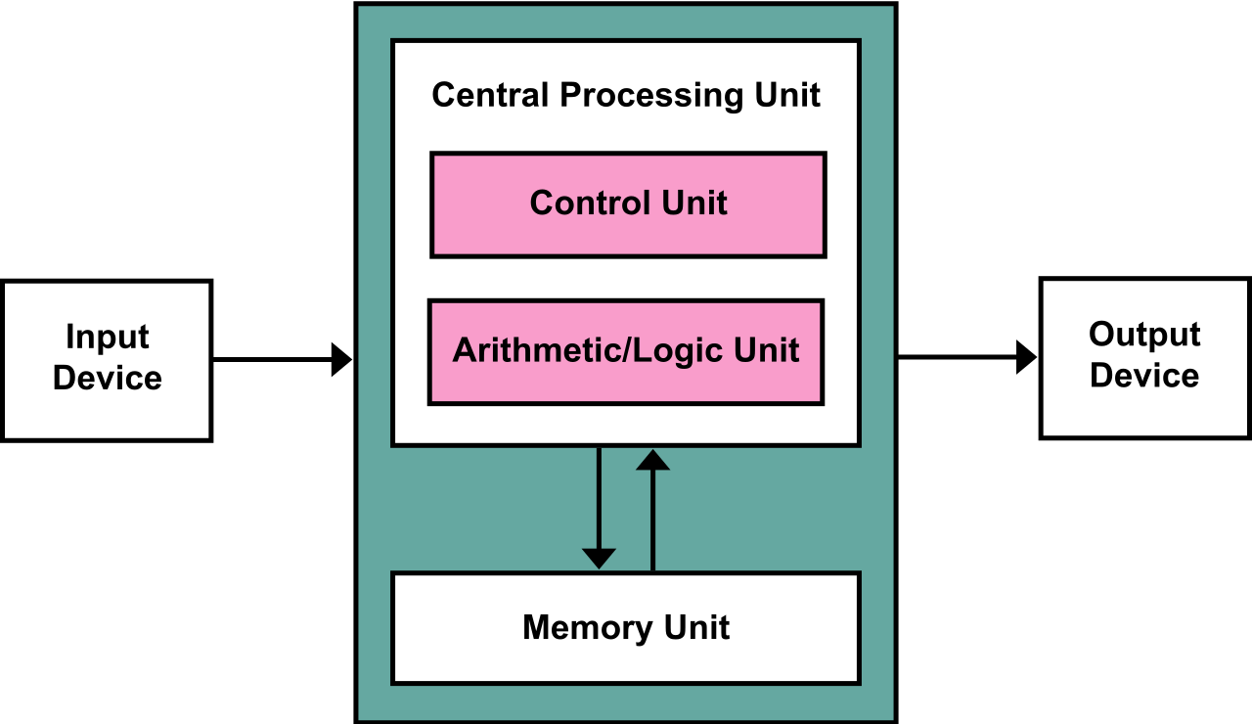
From von Neumann machine to decentralized computation
Basically any device which has a central memory, and a CPU can perform computation.
Information on how to perform it are stored in the memory
CPU reads the instructions and perform them
And stores its results back on the storage
They can be sent outside with an output device
Source: https://commons.wikimedia.org/wiki/File:Von_Neumann_Architecture.svg#/media/File:Von_Neumann_Architecture.svg

Slide 13
From von Neumann machine to decentralized computation: Ethereum Virtual Machine
With a blockchain platform, we have a powerful decentralized, immutable, accessible and decentralized memory
We have all the CPU that we want (the nodes)
So why not make computations with them?
What if we use the blockchain not only for storing information, but also for storing programs that can be ran by the blockchain nodes, that will then write their outputs on the blockchain itself?
Source: https://commons.wikimedia.org/wiki/File:Von_Neumann_Architecture.svg#/media/File:Von_Neumann_Architecture.svg

Slide 14
Questions
Your questions?

Slide 15
The Ethereum Virtual Machine: smart contracts
Ethereum Blockchain, first devised by Vitalik Buterin in 2013 (He was 19 years old) is a blockchain protocol capable to execute programs stored on its ledger.
Other than the classical blockchain actions, it is possible to upload entire ‘’programs’’ on it (called smart contracts) which will be executed by the mining nodes.
In practice, a lawyer would say you are signing a contract with the blockchain, in which you ask it to perform some actions in exchange of a payment!
The contract will be executed as it is (it is fully deterministic), so be careful and avoid bugs.

Slide 16
The Ethereum Virtual Machine: smart contracts
When created (instantiated) smart contracts become part of the blockchain operation. They are “installed” on an address, exactly equal to users’ ones, and can be accessed by anyone by means of theyr input/output functions
It is anyway possible to include in them instructions which limit the spectrum of addresses which can have access to some or all of they functionalities.

Slide 17
Exercise 3: creating and interacting with smart contracts
We’ll move again to jupyter notebook for exercises on the creation and interactions with smart contracts, plan is:
To show how you can create a smart contract
To teach you how to interact with it
How to access their features
How to devise an automatic way to interact with a worldwide spread, immutable, trustless and decentralized virtual machine
How to perform a simple auction without the need of guaranteeing third parties

Slide 18
Questions
Your questions?

Slide 19
Thank you for your attention!
www.smartgridsmaster.eu

